Slide 1
Patient Safety Report classification with generative LLMs
Presenter: Zhifei Dou

Slide 2
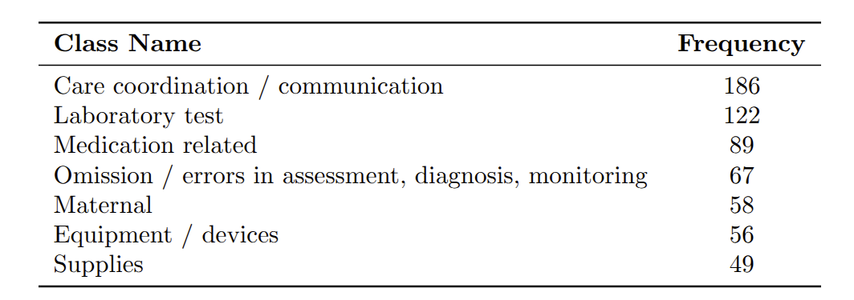
Dataset - Patient Safety Event Report
The dataset contains 861 Patient Safety Event (PSE) reports which records the events causing safety issue for hospital patients in free text.
These are all classes adopted from the PSE report
Confidencial dataset can only be processed locally
Content: Patient need a EPIC, no available one…
Label: Equipment/devices

Slide 3
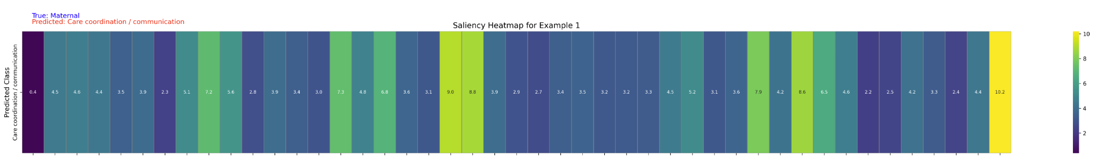
Motivation
Correct classifications and explanations of such PSE reports are vital for preventing patient injuries.
How are PSE reports classified and explained now?
Classified with BERT (and variants) embedding and Machine Learning models or a fine-tuned BERT (and variants) with a classification head
Explained with Explainability tools: Saliency, SHAP, and LIME -> saliency map
Current drawback and potential improvement:
Study shows clinicians might be distracted by saliency maps or don’t trust it due to the complexity.
Potentially be improved with generative LLMs with natural language explanation (NLE)

Slide 4

Methods - LLM Choosing
Mainly Qwen 2.5 series from Alibaba AI: Qwen14B, Qwen32B, QwQ, Deepseek distilled Qwens
Rationales:
Confidencial dataset, no API, no cloud server
One of the most widely used open-sourced LLMs
More scale options compare with others like LLaMA
Unique advanced 32B scale reasoning model -> QwQ
(LLaMA failed functions in HF, resulting null output)

Slide 5
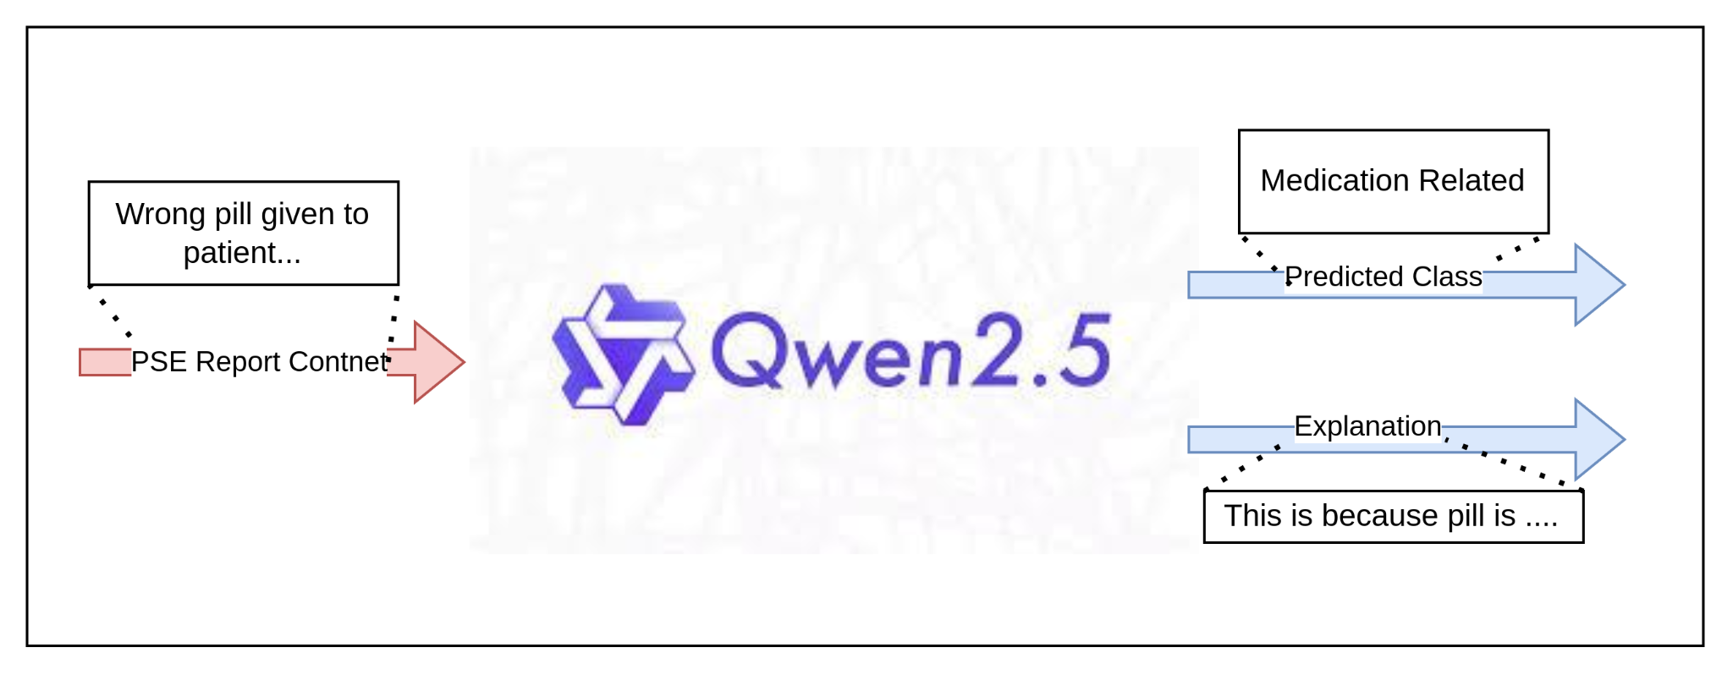
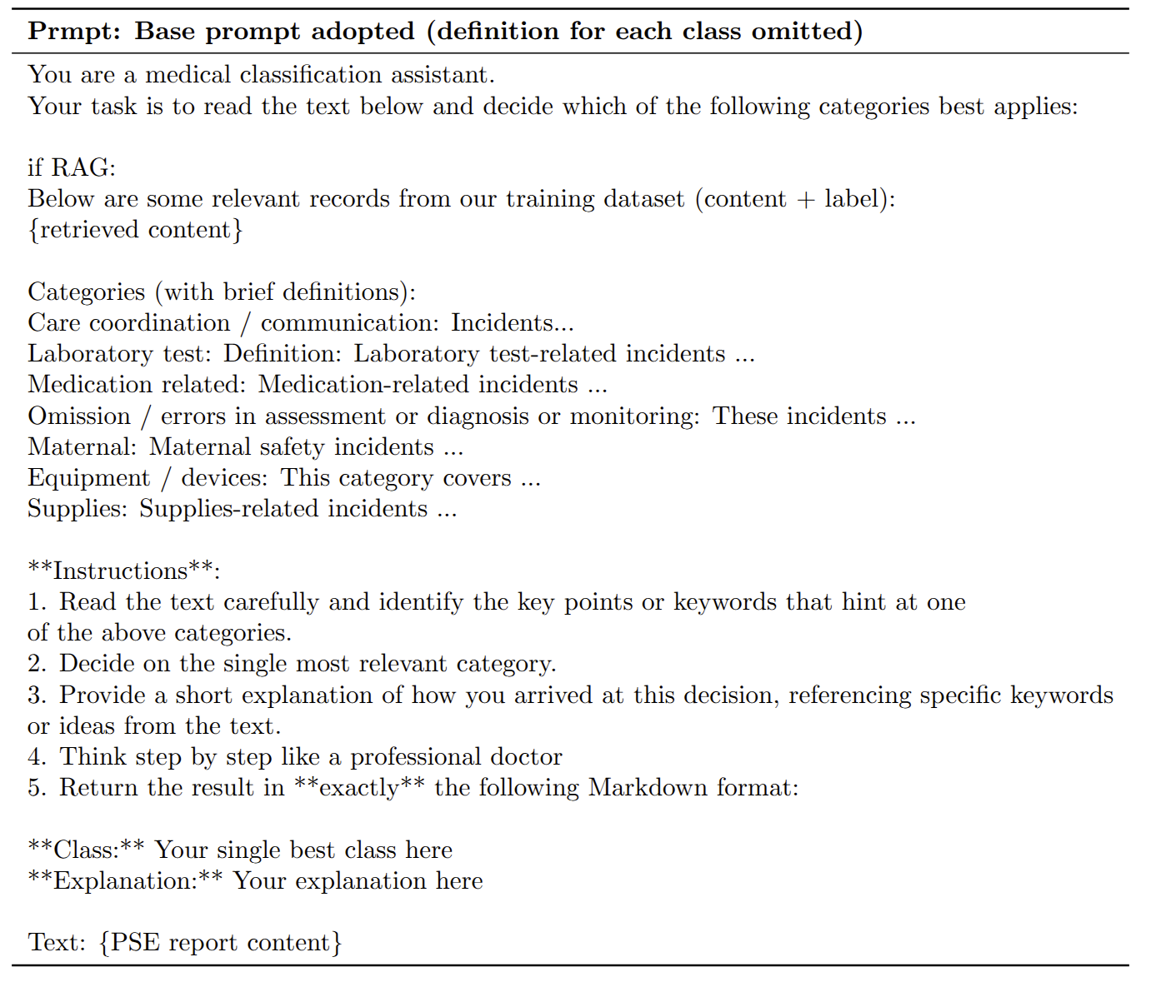
Methods - Instruction-Based Learning Classification
Zero-shot: Simply input the prompt on right
Retrival Augmented Generation (RAG): Adopted a BioBERT’s embedding to map report contents for retrieval. Then input the prompt on right
Self-Consistency: Run the generation process for multiple times and take majority voting for result
Output: 1. Classification Prediction 2. Explanation for the prediction in natural language
Evaluate with accuracy, F1-score, recall….

Slide 6
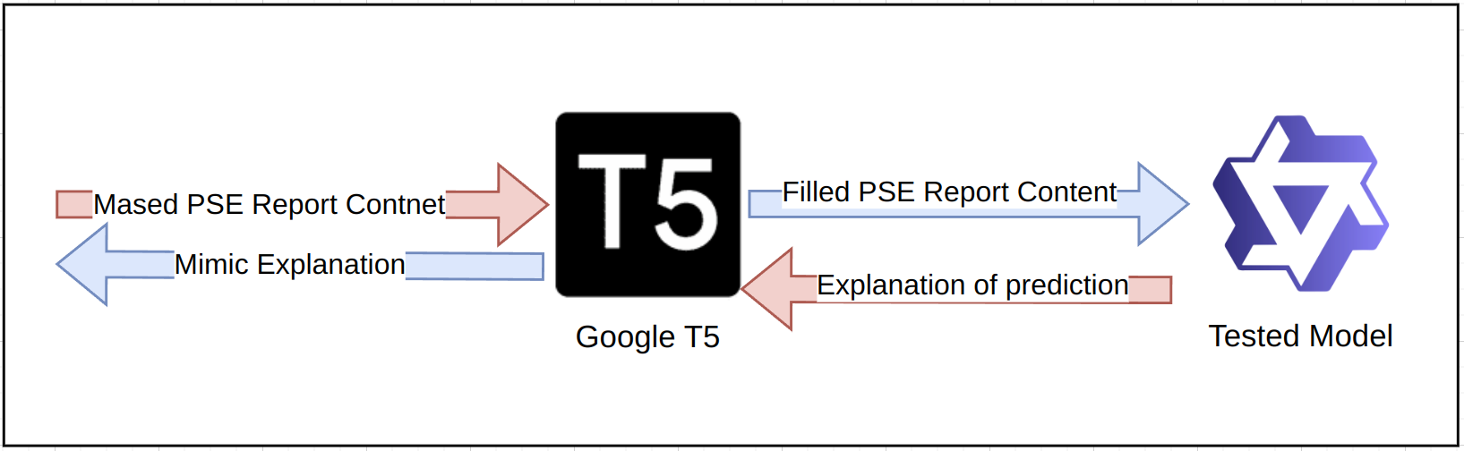

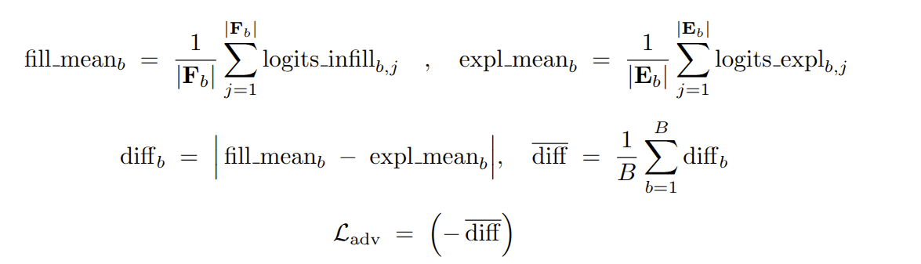
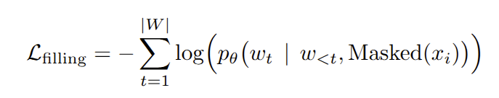
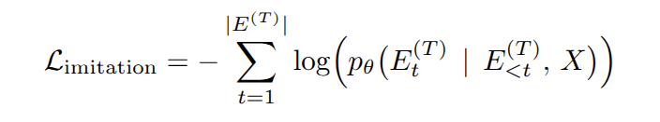

Methods - Evaluate Explanation Faithfulness
Fill the masked report with T5’s predicted words
Faithfulness: Does the explanation reflects the internal decision process of a model?
Counterfactual editor:
Counterfactually edit the content and check if the LLM make same prediction with the edited content
Fine-tune a T5 model with the following editor loss and edit:
Do teacher forcing on the tested model’s explanation and calculate loss
Intuitively speaking, we are just trying toteach the T5 model to fill in masks with word that make tested model’s explanation as different from original ones as possible to ‘fool’ the model

Slide 7
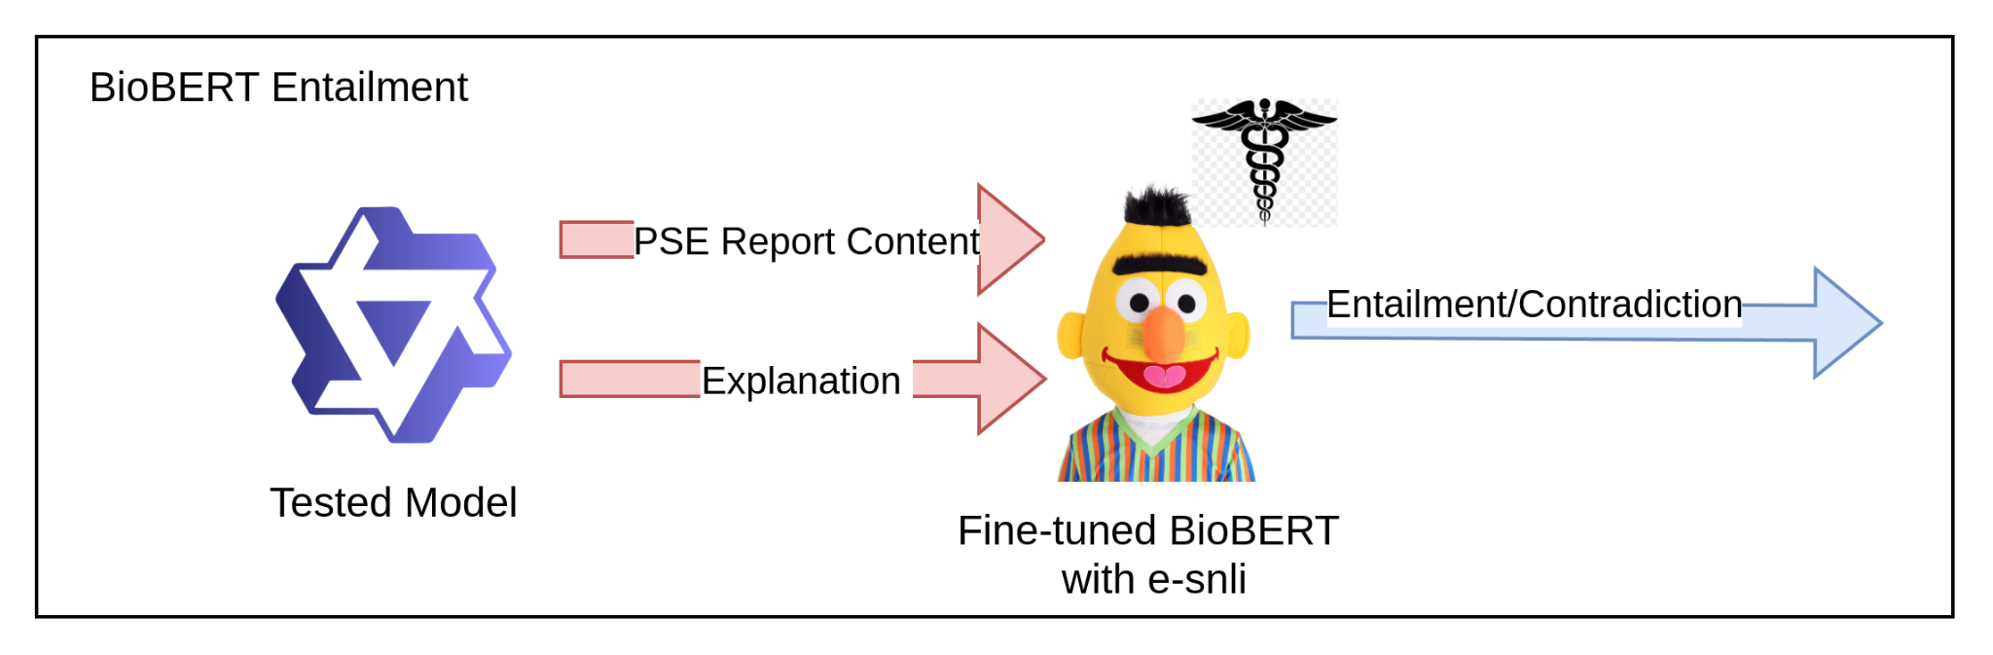
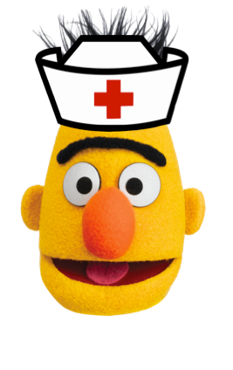
Method: Evaluating Factual Correctness
Factual Correctness: If the model’s explanation is factually correct according to content or medical facts. For high-stake healthcare domain, the explanation should be plausible for medical experts and free from hallucination.
BioBERT Entailment: Fine-tune a BioBERT model with e-SNLI inference dataset, and input the original content as premise and explanation is hypothesis. If the explanation is factually correct, it would not be contradict with the original content.
Dataset contains premise, hypothesis, and relationship (entailment/natural/Conta-diction) as label

Slide 8
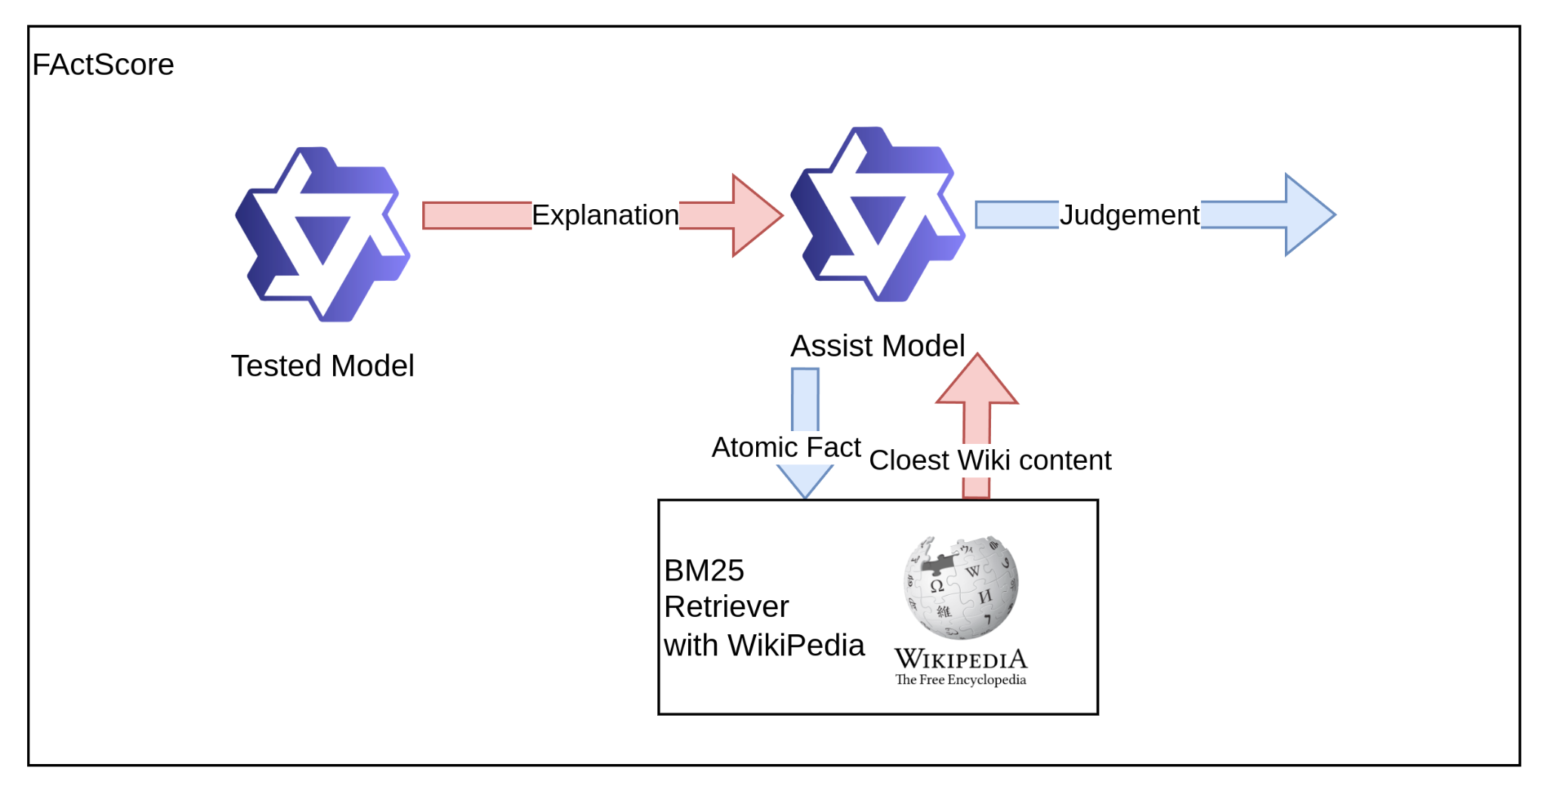
Method: Evaluating Factual Correctness
Factual Correctness: If the model’s explanation is factually correct according to content or medical facts. For high-stake healthcare domain, the explanation should be plausible for medical experts and free from hallucination.
FActScore: Adopt an assist LLM to break the explanation into atomic facts then retrieve the closest fact from Wikipedia with BM25, adopt assist LLM to judge if the atomic facts is supported by the retrieved Wikipedia fact. The more atomic facts got supported, the more factually correct a model’s explanation is (finally result in x% of facts are supported among all).

Slide 9
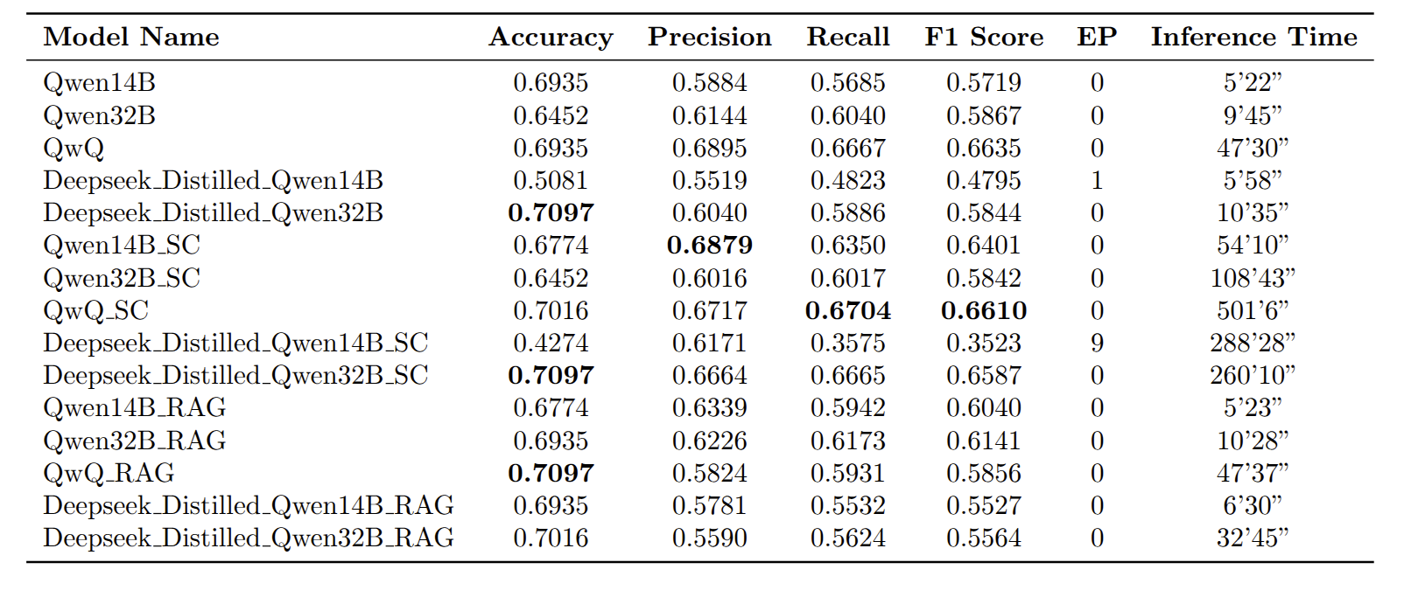
Result - Classification Result
Overall good performance compare with previous work (74%), most model achieved 70% accuracy
Classification Result is demonstrated on the RHS:
Reasoning models with self-consistency usually performs the best but takes much more times than RAG and zero-shot
Deepseek distilled Qwen32B with RAG has the most efficient performance, got the best accuracy within the shortest time
Smaller model produce null predictions
SC: Self-consistency EP: Empty Prediction RAG: Retrieval Augmented Generation

Slide 10
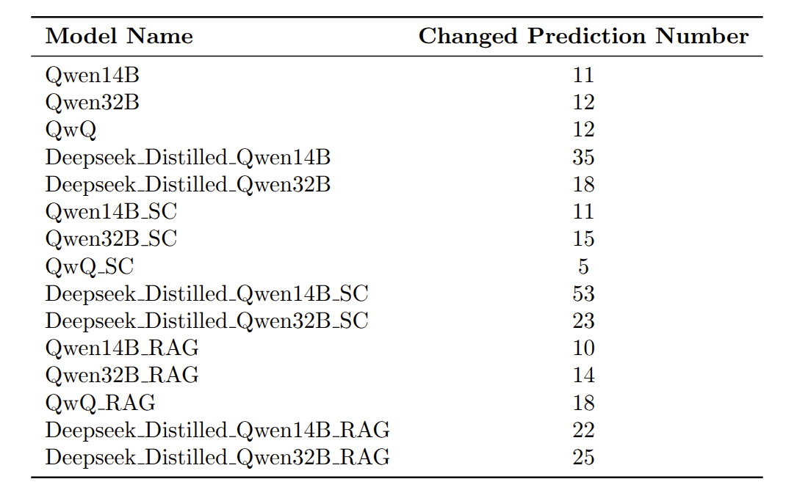
Result - Evaluation Result Faithfulness
The result of faithfulness evaluation is demonstrated on the rhs:
Distilled models are generally not faithful. Potentially caused by the teacher-forcing, even though the model is predicting the correct label, the internal reasoning path, which simulates a larger model, is not stable.
Self-consistency can magnify a model’s unfaithfullness.

Slide 11
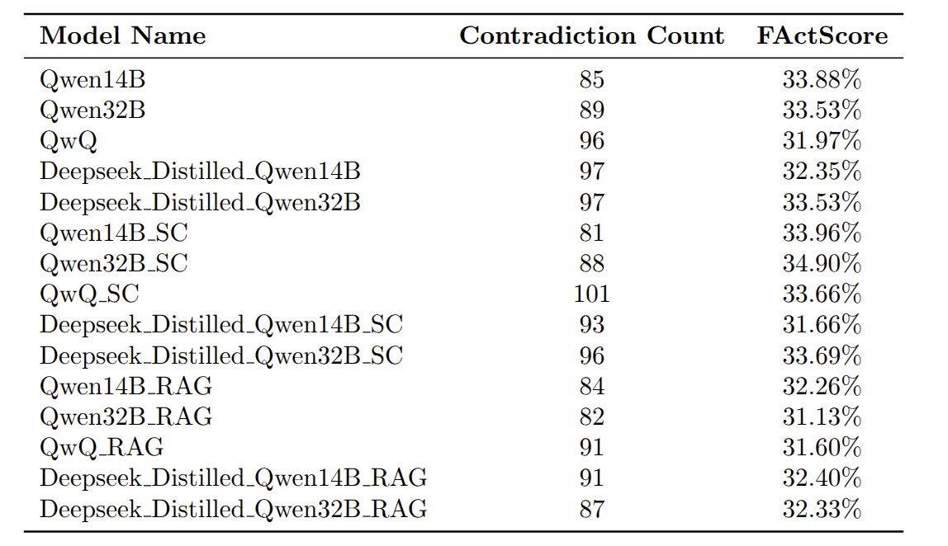
Result - Evaluation Result Factual Correctness
The result of Factual Correctness is on the rhs:
All models’ explanations are considered less factually correct according to both BioBERT entailment and FActScore methods.
Potentially caused by the lack of medical dataset during pre-training and fine-tuning when the tested LLMs were processed.
Both evaluation methods needs ablation test ,such as changing assist model adopted by FActScore, to further ensure the result is trust-worthy.

Slide 12
Conclusion & Future Work
Conclusion: Middle scaled LLMs with proper techniques can have decent performance in PSE report classification, but the natural language explanation produced alongside with the prediction needs to be treated carefully as unfaithful and factually incorrect explanations are observed
Future work:
Consult domain expert and manually sample and evaluate the explanations to validate the evaluation result.
Ablation test on factually correctness evaluation metrics
Expending the model to medical domain LLMs

Slide 13
Thank You!
Q & A

